Slide 1


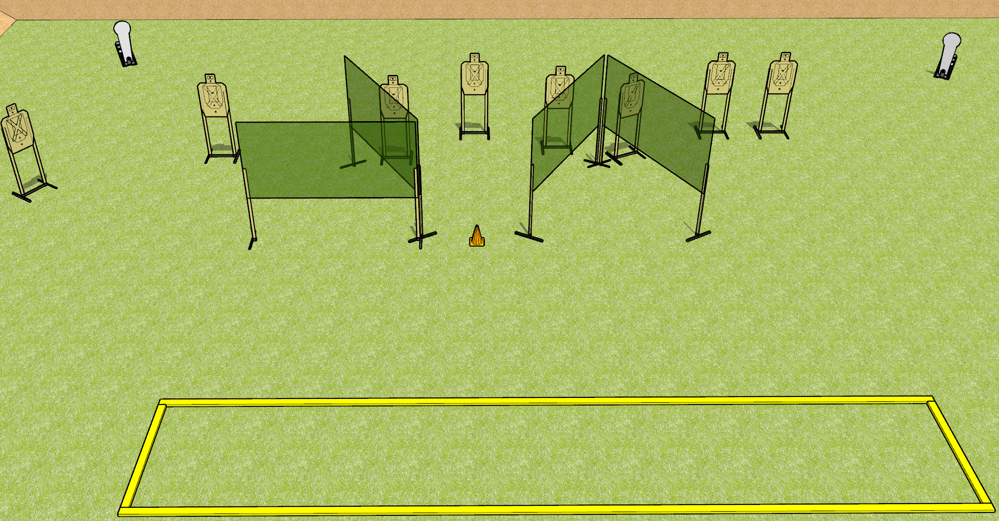
 | Dothan Gun Club – USPSA Match Something Borrowed Course Designer : Drew Coleman
START POSITION : Standing with both feet on outside the shooting area, wrists below belt
GUN READY CONDITION : Pistol loaded and holstered. PCC loaded, shouldered, safety on, pointed at orange cone. |  | SCORING: Comstock, 26 rounds TARGETS: 8 paper, 2 Steel SCORED HITS: Best 3 on paper, steel until down START-STOP: Audible, last shot RULES:
STAGE PROCEDURE: Engage targets as they become available from within the fault lines.

Slide 2
Something Borrowed
Written Stage Briefing
Something Borrowed is a 26 round, 130 point, Comstock Long Course. There are eight USPSA targets and two Colt Poppers. The best three hits per paper target will score and steel must fall to score. The start signal is audible.
Handgun start position is standing with both feet outside of the shooting area, wrists below belt. Handgun is loaded and holstered.
PCC start position is standing with both feet outside the shooting area. Loaded carbine is held with both hands, safety on, shouldered, pointed at orange cone.
Upon start signal, engage targets as they become available from within the shooting area.
Admin note: yes I did steal this from nationals.

